Slide 1

Early Warning for Collections tool
Executive presentation
Funding Credit team
Analysts:
Kevin M. Figueroa
September 19th, 2022

Slide 2


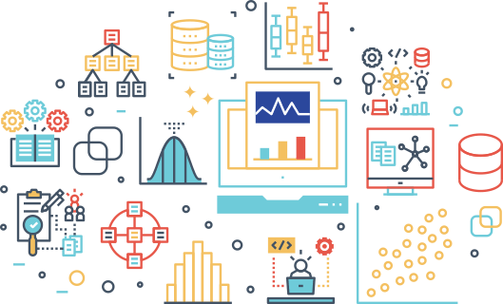
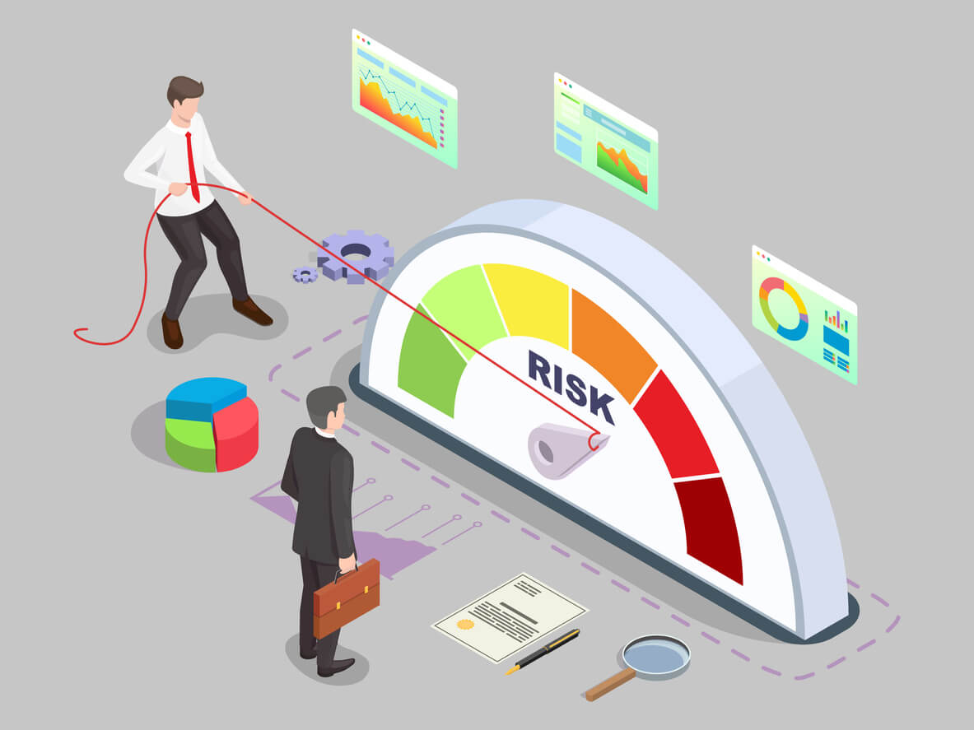
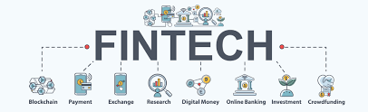
About me
BA in Economics and finance
MA in Economics and data science
5 years in economic and financial consulting
Fintech consultant: Risk Analysis
Last week: Stride Credit Risk Analyst

Slide 3
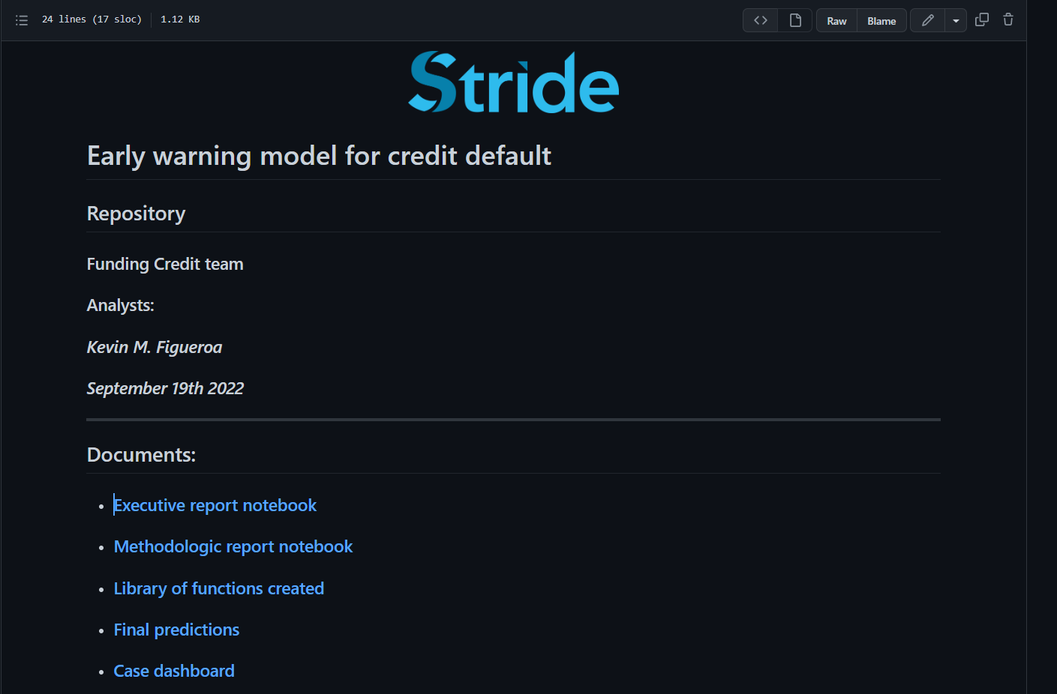
Navigating repository

Slide 4
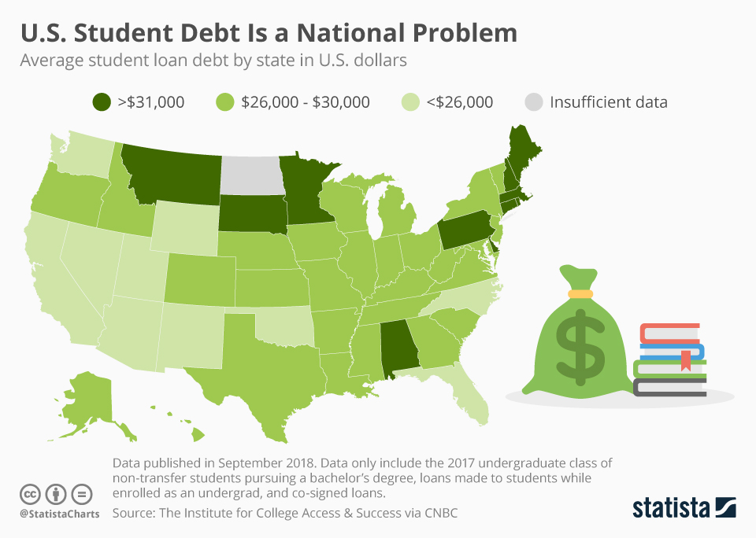

Fintechs' challenge in the growing student loan market
Fintech → Competition : Reduce the cost of credit and increase financial inclusion
Market size: 44 million borrowers who collectively owed USD 1.5 trillion in student loan debt
Average student in the Class of 2016: $37,000
Student loan evaluation challenge!
Longer terms than BL
Drastical conditions change for a graduate, unlike mortgages
No collateral
1-4 yrs to first payment

Slide 5

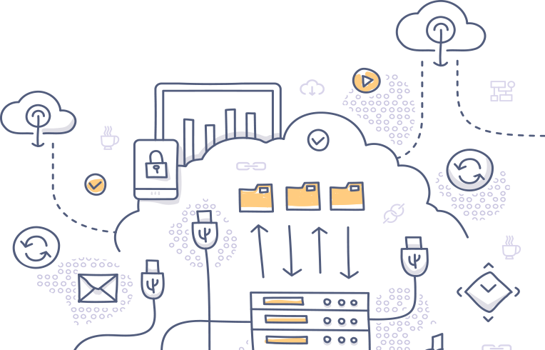

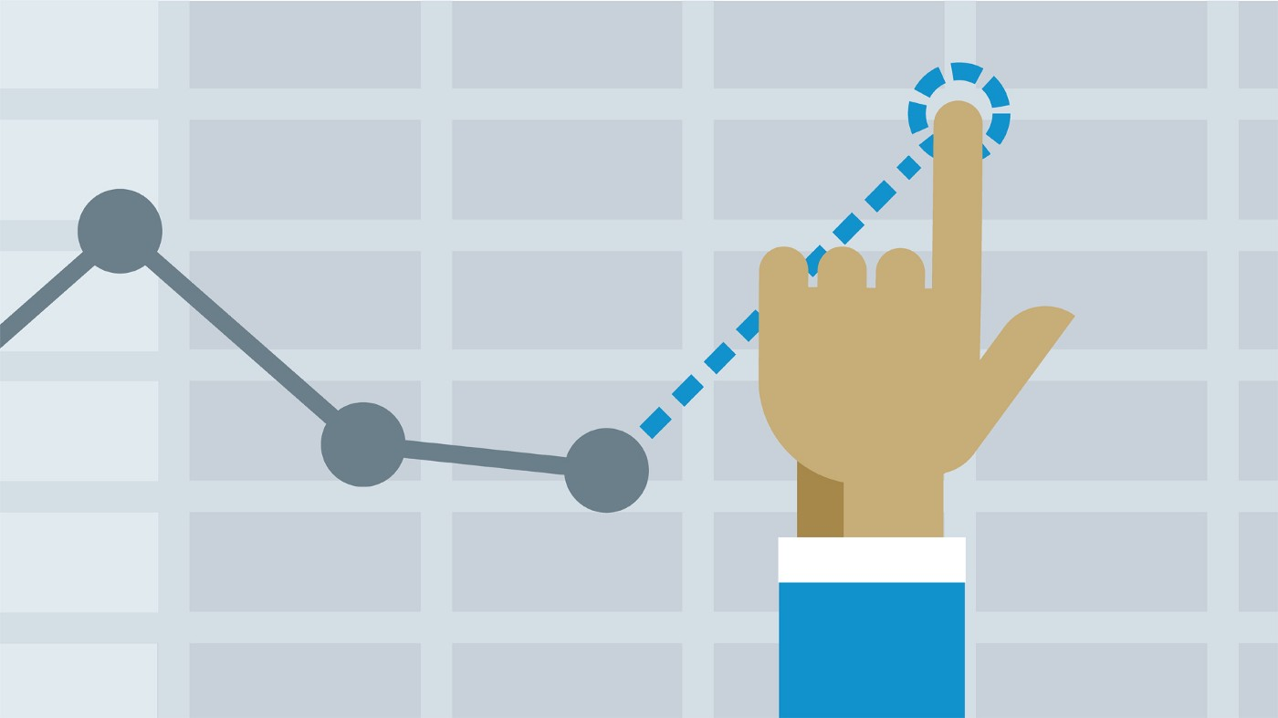
Purpose
Leverage all data available
Database found but documentation is missing
Our task: obtain as much insight as possible that could be useful to improve Stride's operations
Specific objectives:
Perform a deep exploratory data analysis process to understand as much of the data as possible.
Clean the data.
Produce a model that can help identify loans at risk of default.
Predict defaults in current portfolio loans.
Propose a business strategy that can take advantage of the predictive power of the model.

Slide 6
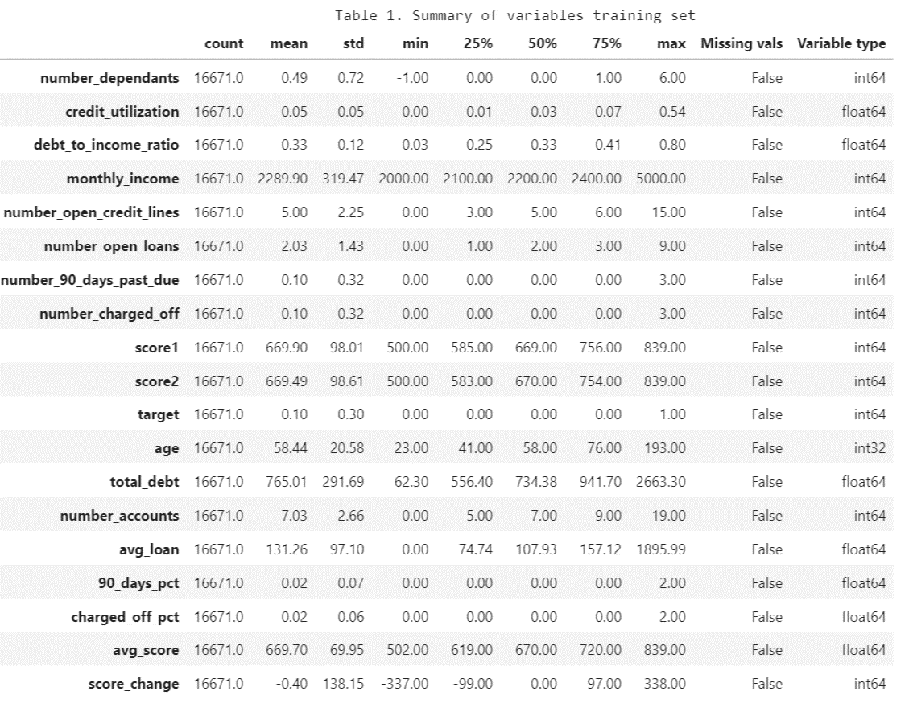
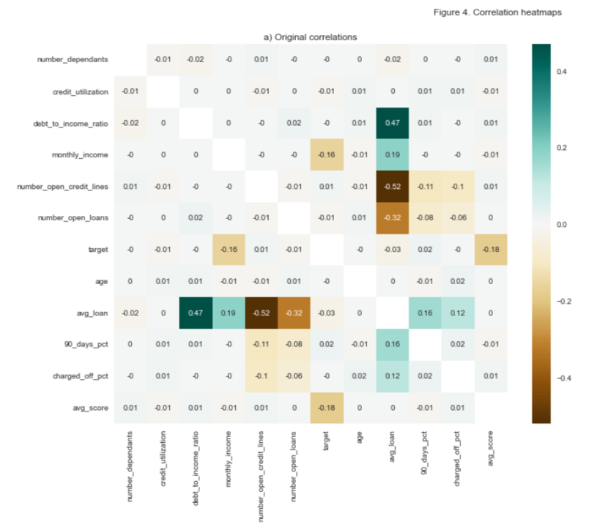
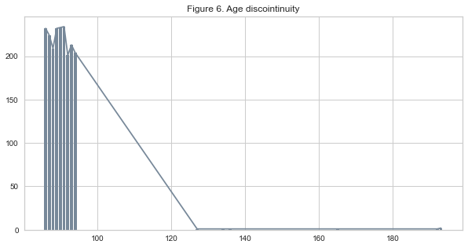
Exploratory data analysis s results
Description of the data and new features
Score mistery: source? date?
Number of dependants issue: (-1)
Age issue
Scales to standarize and Weak correlations

Slide 7
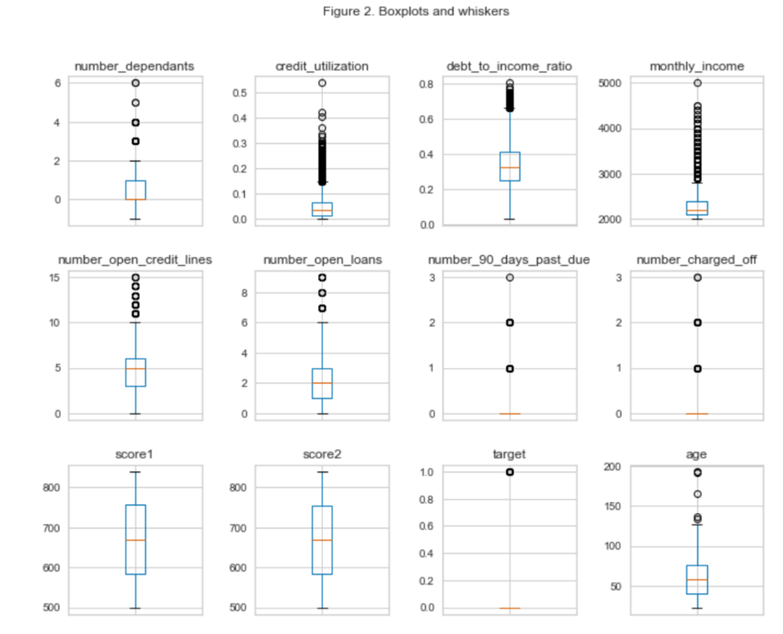
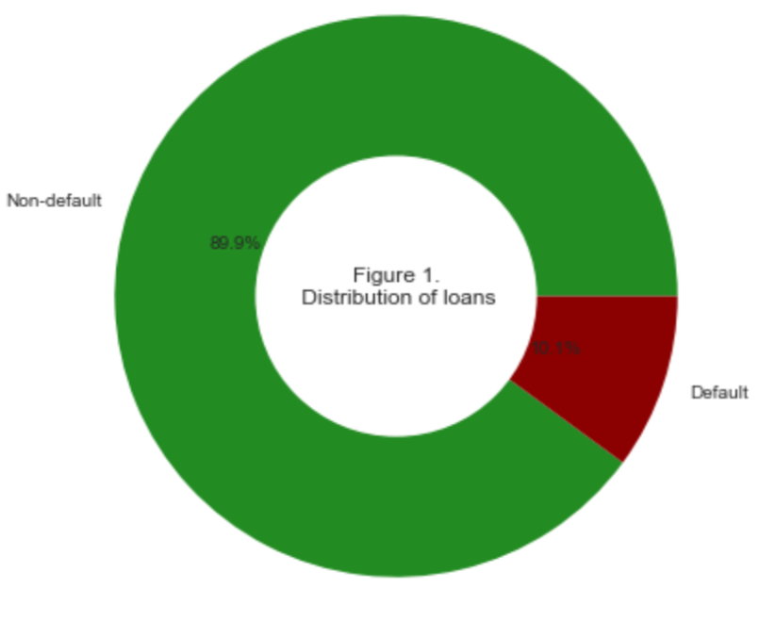
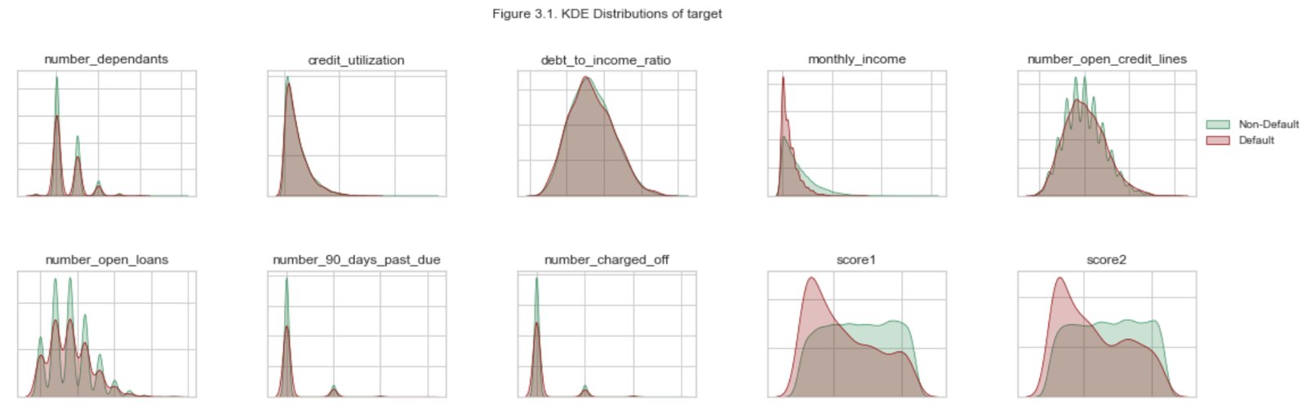
Exploratory data analysis results
Description of the data
Unbalanced Terget distribution
Features Distributions
No clear segmentation → Weak correlations

Slide 8
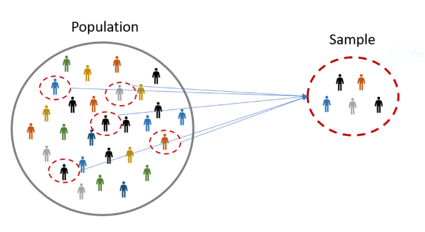
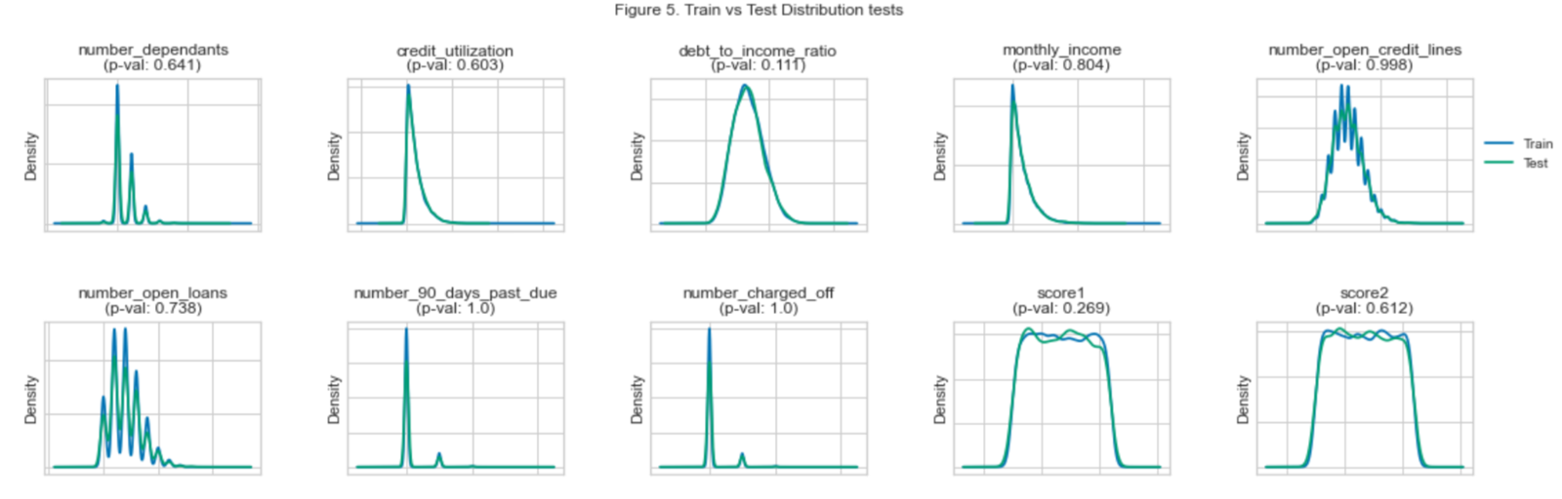
Evaluating if both samples were drawn from the same population
Kolmogorov-Smirnov tests for 2 samples
H0: Both samples share the same distribution
Reject if p-val <= 0.05
Testing and objective data come from the same population
All variables for both sets were drawn from the same distribution → Same populations

Slide 9

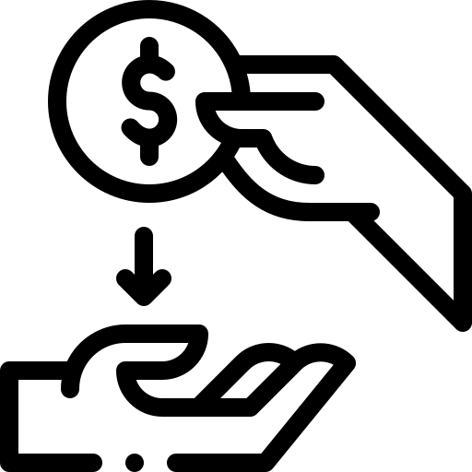



What can be done with this dataset? Early Warnings for Collections (EWC) tool
Not useful data the evaluate loan applications
Timing mistery: 75% of ages over 41 years → follow-up data during collection.
Useful to track loans and predict if an already existing loan is likely to default any time soon

Slide 10



Additional variables to consider
Number of loans with stride (internal data)
Loan terms (internal data
Initial date (internal data)
Information about the program to attend (require acceptance letter during the application.
GPA (require transcripts of previous academic levels and follow-up after graduation
Gym membership (ask during application)
Loan percentage repaid (internal data):

Slide 11

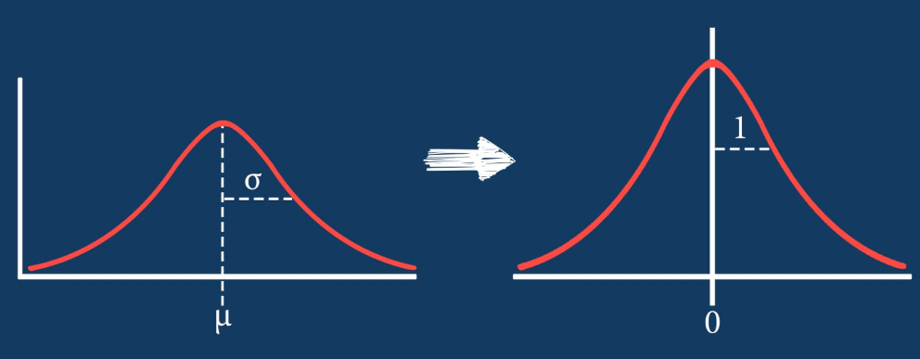
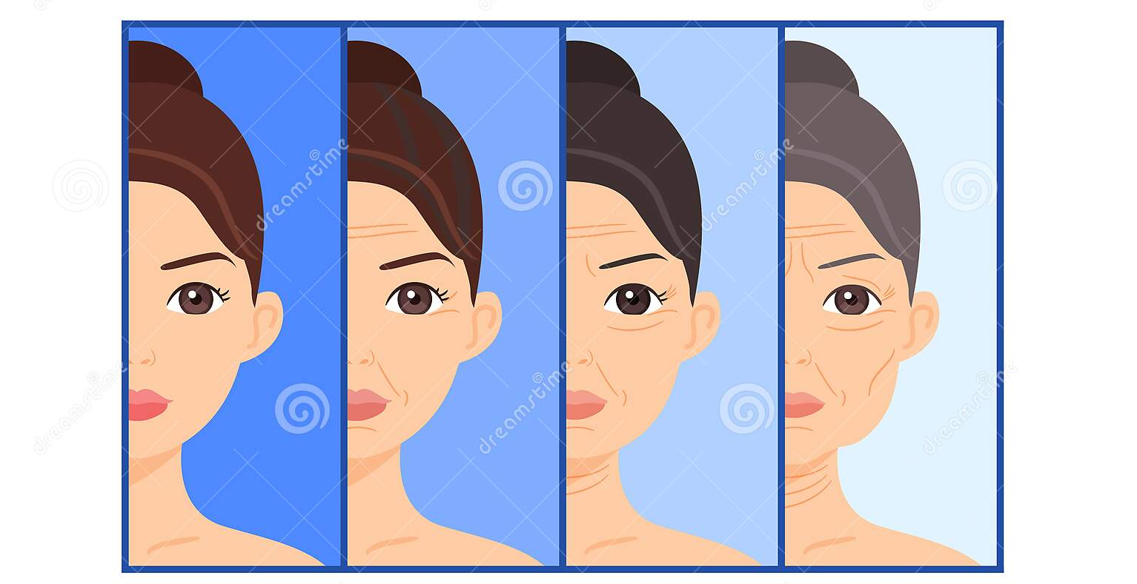
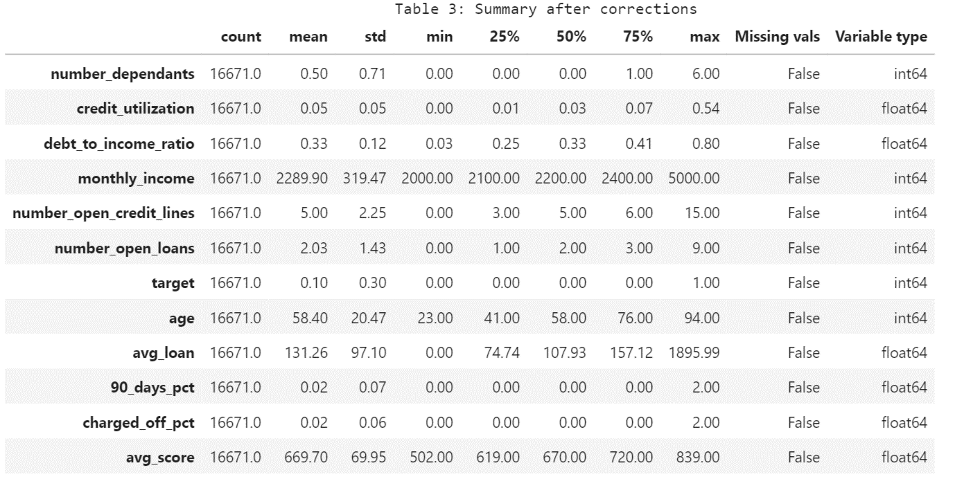
Data cleaning
Filling missing values (-1): Mode
Fixing ages: Subtracting 100 years to faulty observations
Standardization (after splitting to avoid leakage)

Slide 12
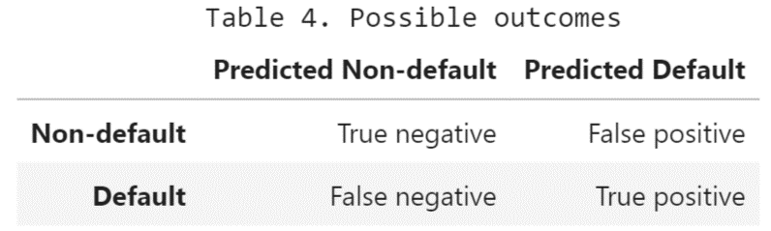
Model creation : contextualizing concepts
Positives observation: Defaulted loans (Contain the target we want to predict)
Negatives observations: Non-defaulted loans (Doesn't contain the target we want to predict)
Evaluation metrics
Accuracy: How is the model predicting both defaulters and non-defaulters?
Precision: What percentage of the default cases predicted were actual defaulters?
Recall: What percentage of the actual defaulters was the model able to predict?
Best evaluation metric → Recall

Slide 13
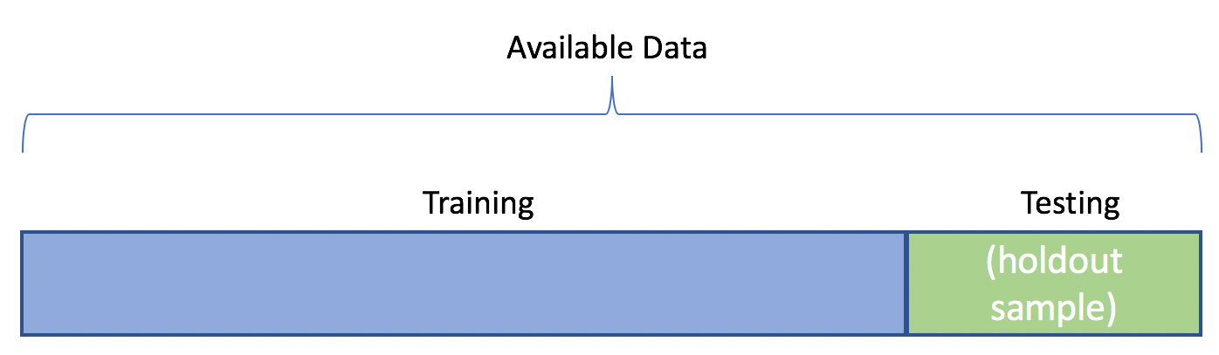
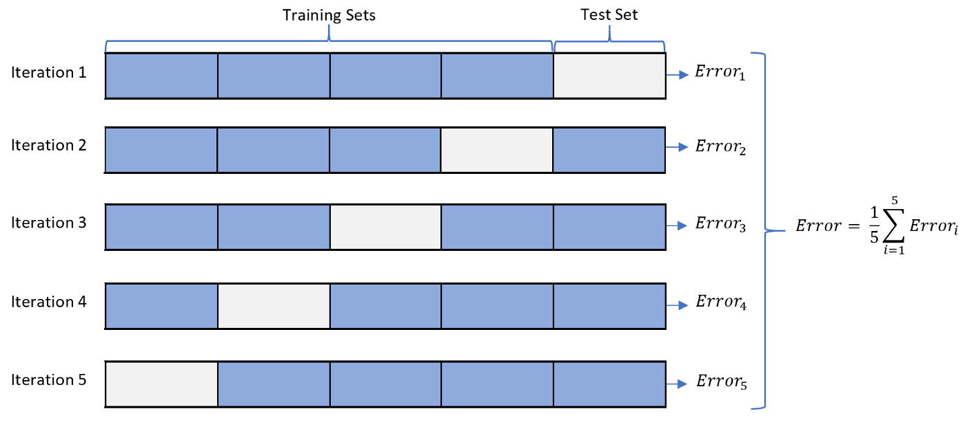
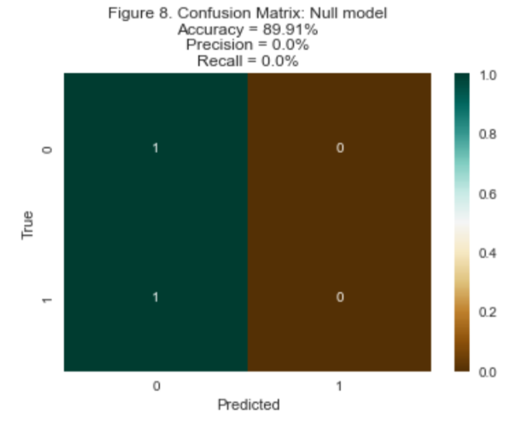
Model creation: Splitting data and null model
80% of the observations (13,336) will be used for training purposes.
20% (3,335) of the observations for testing purposes.
Stratifying: keeping default proportions
Cross validation
Null model no defaulters

Slide 14


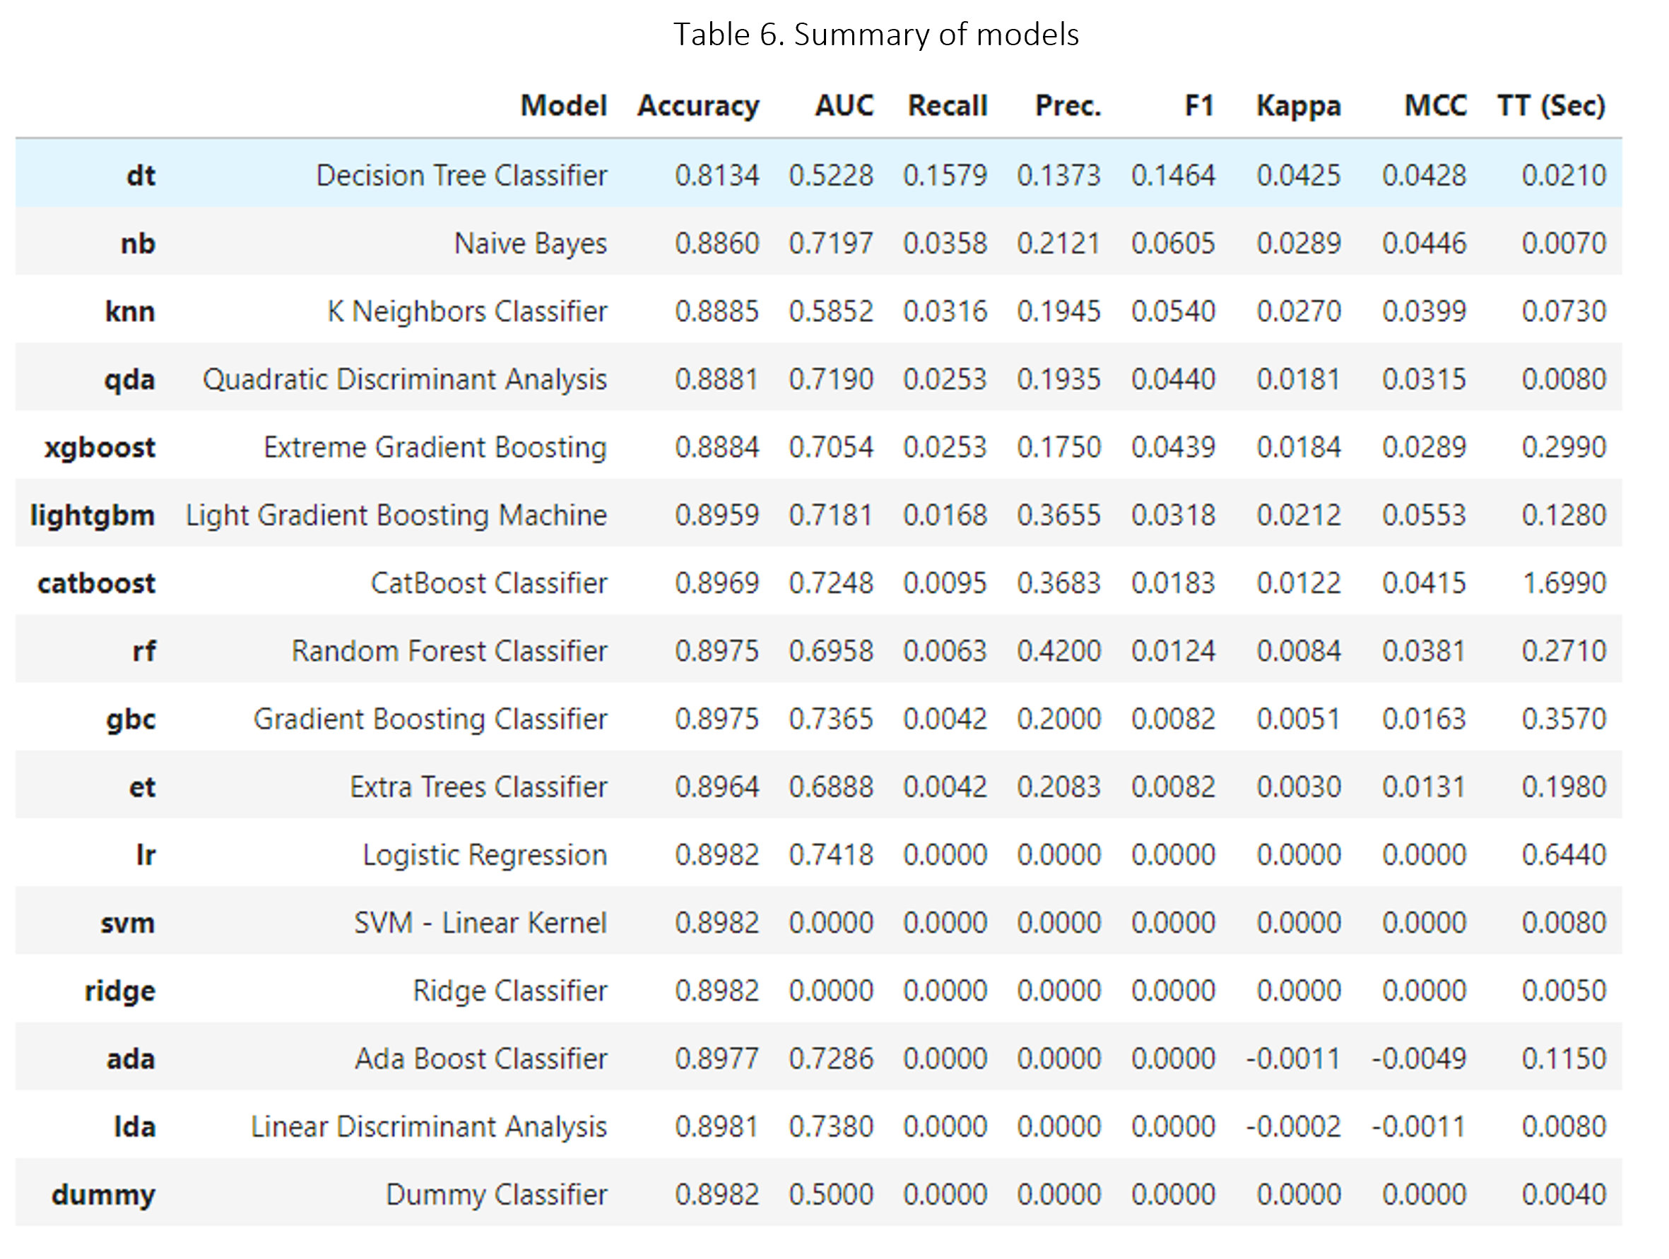
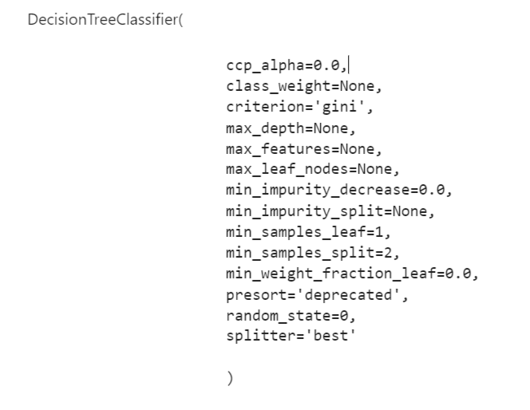
Model creation: PyCaret
PyCaret is an open-source, low-code machine learning library in Python that automates machine learning workflows.
Best model → Decision Tree

Slide 15
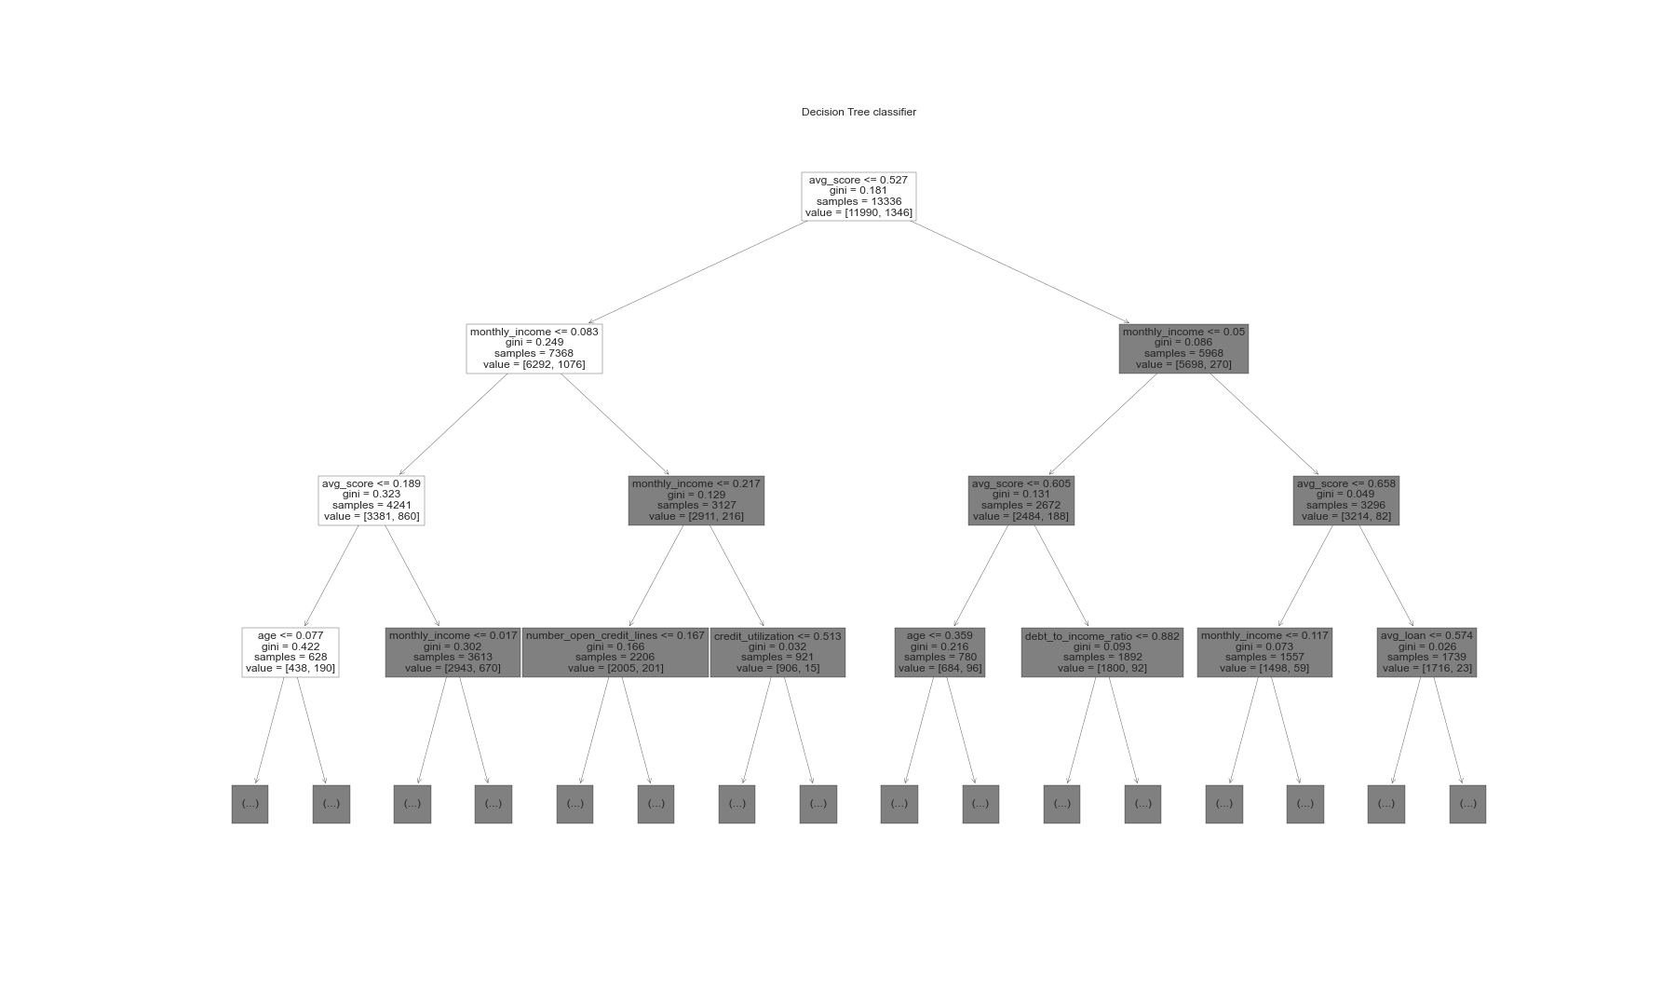
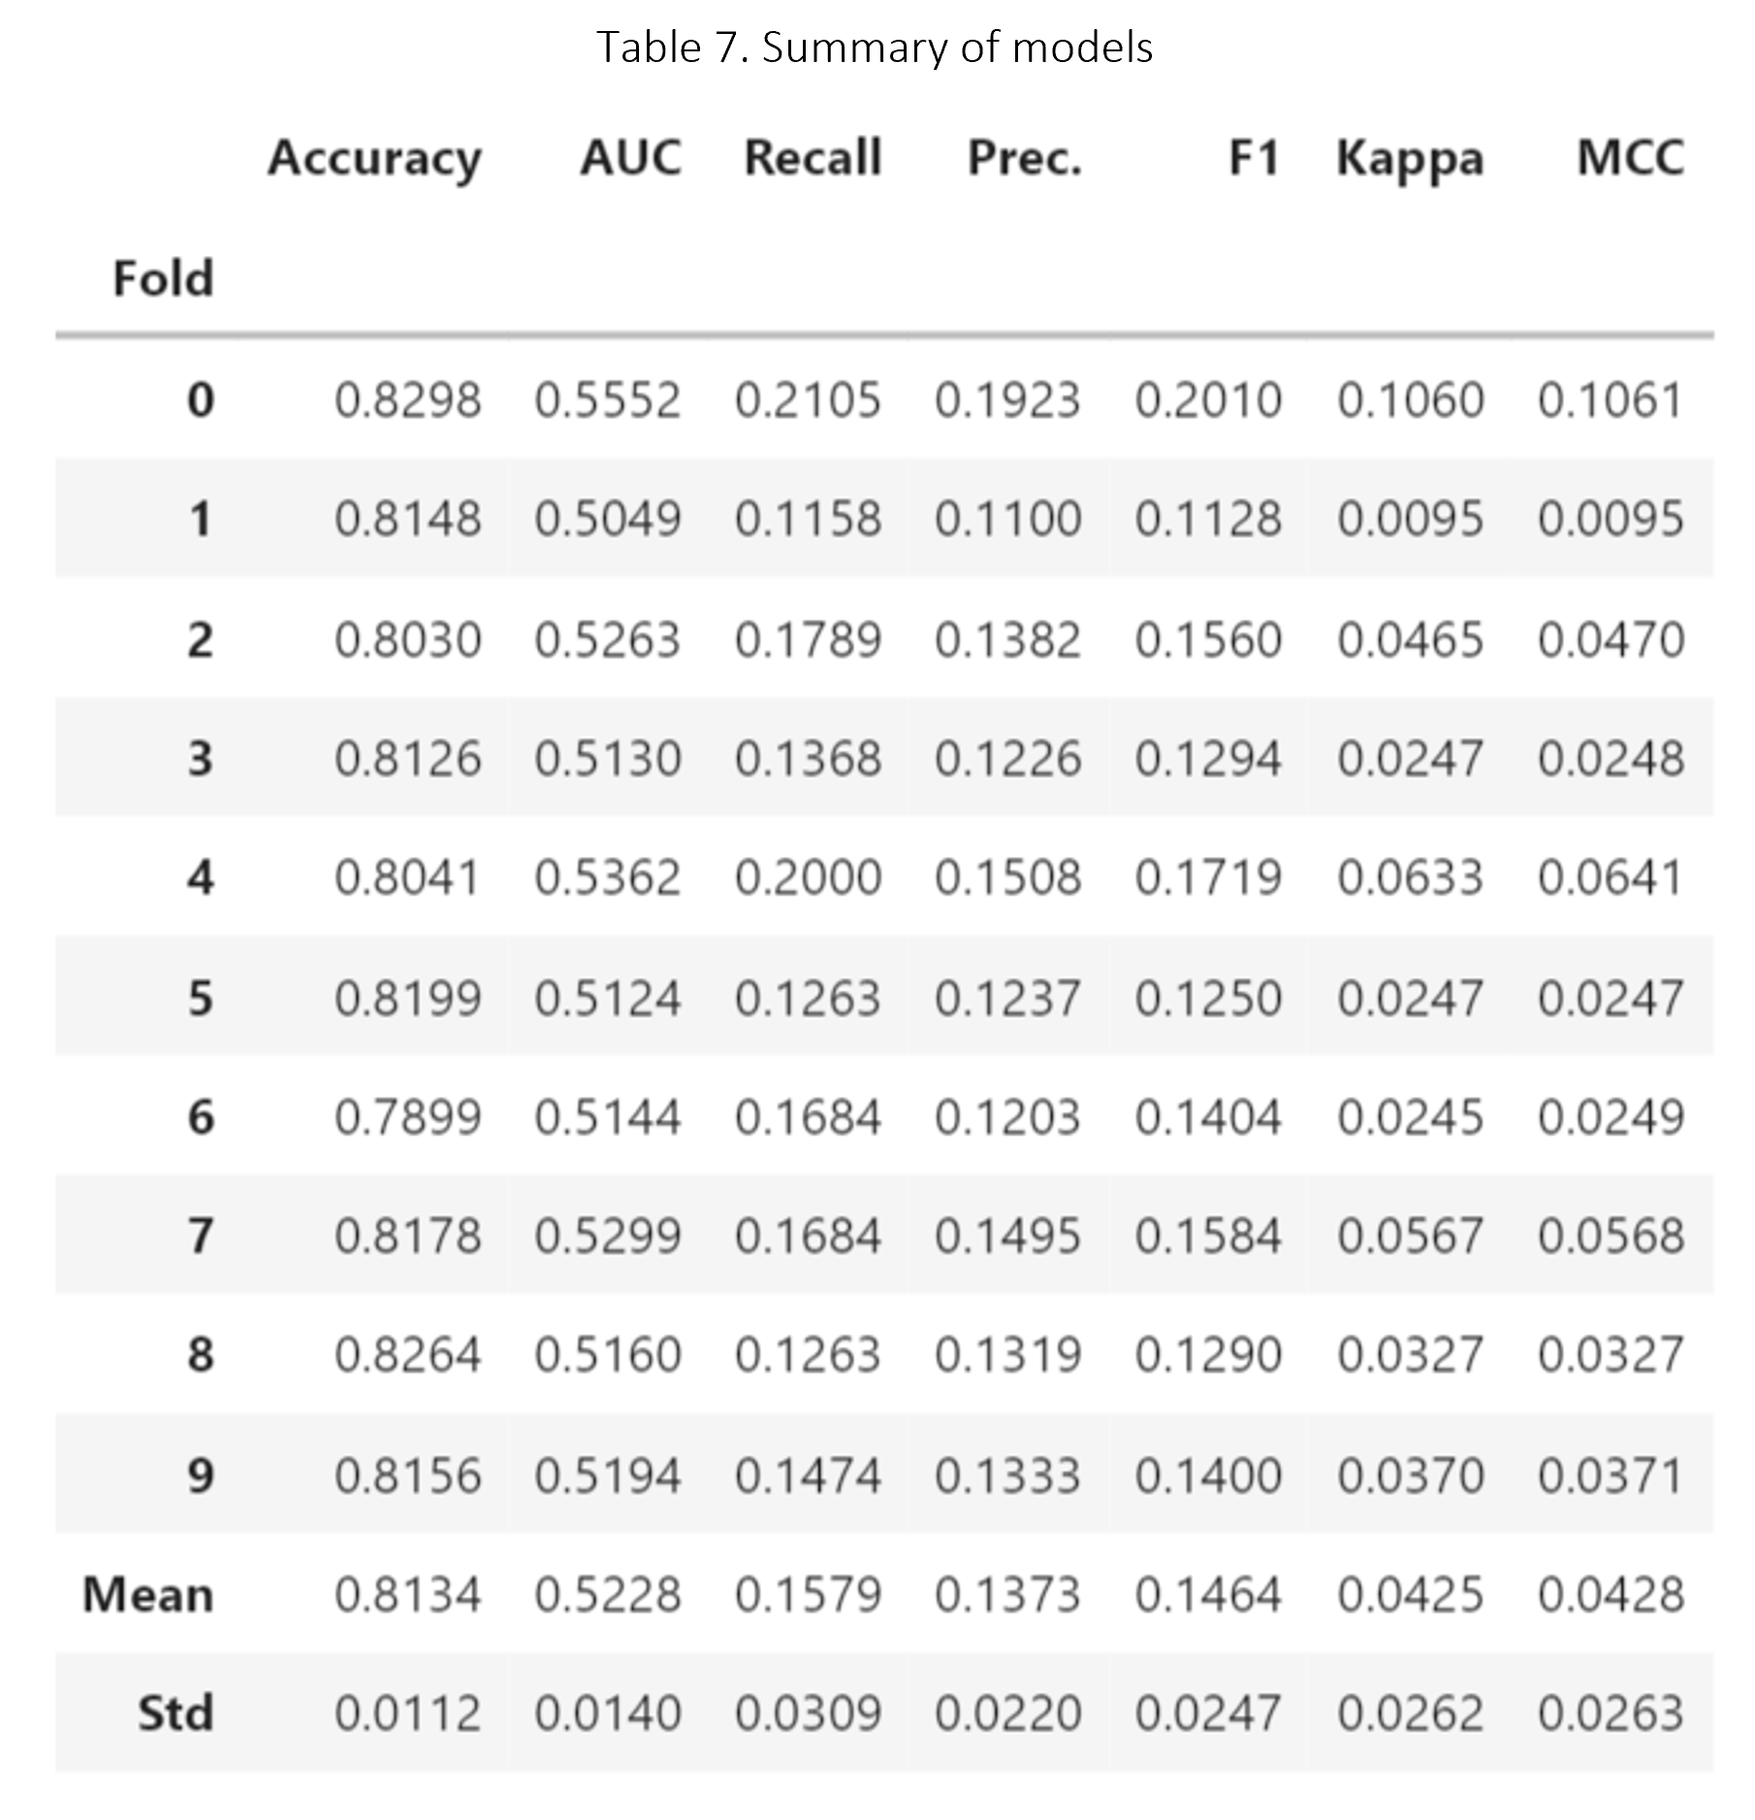
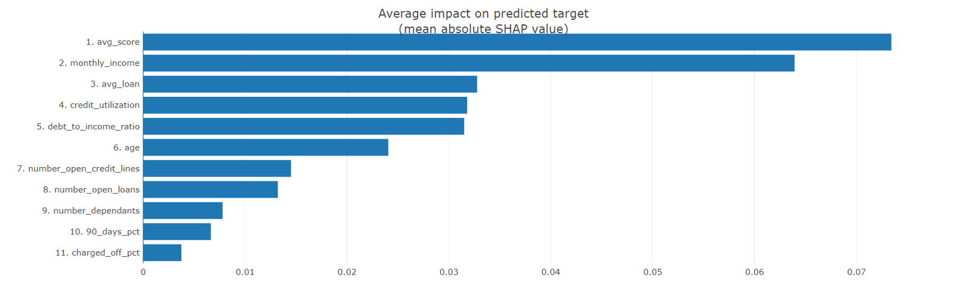
Creating and understanding the model

Slide 16
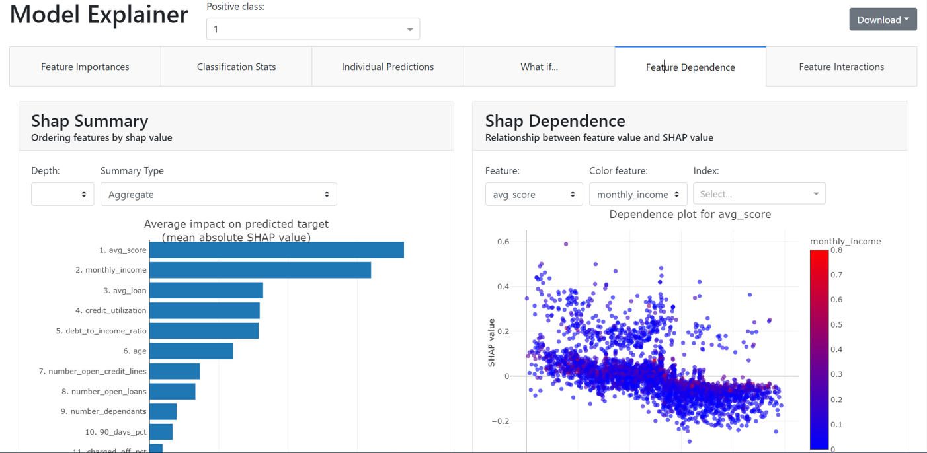
Model explainer Dashboard

Slide 17
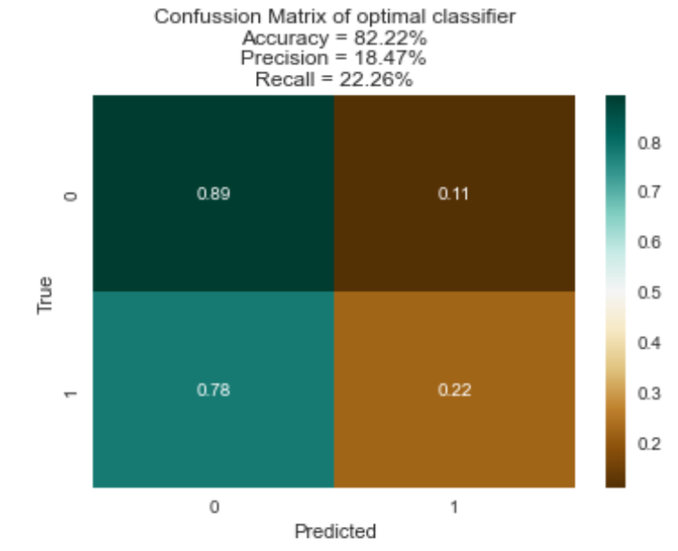
Testing the model and predicting portfolio

Slide 18
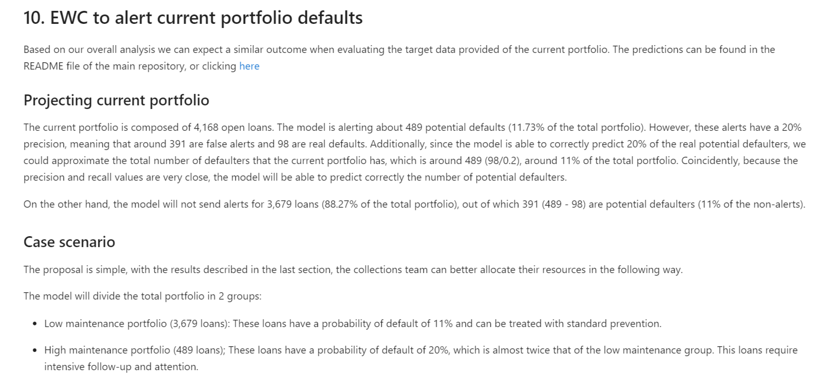
EWC to alert current portfolio defaults

Slide 19
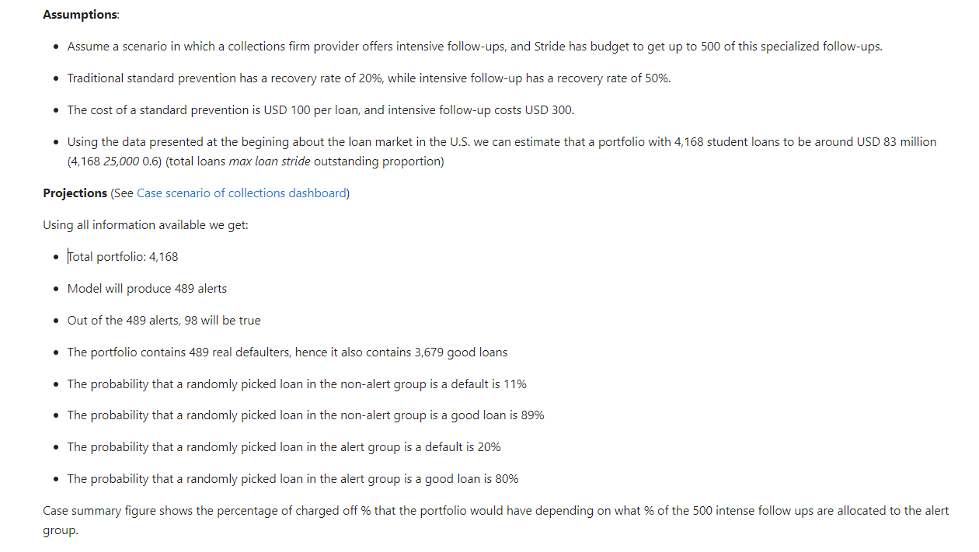
EWC to alert current portfolio defaults : See report

Slide 20
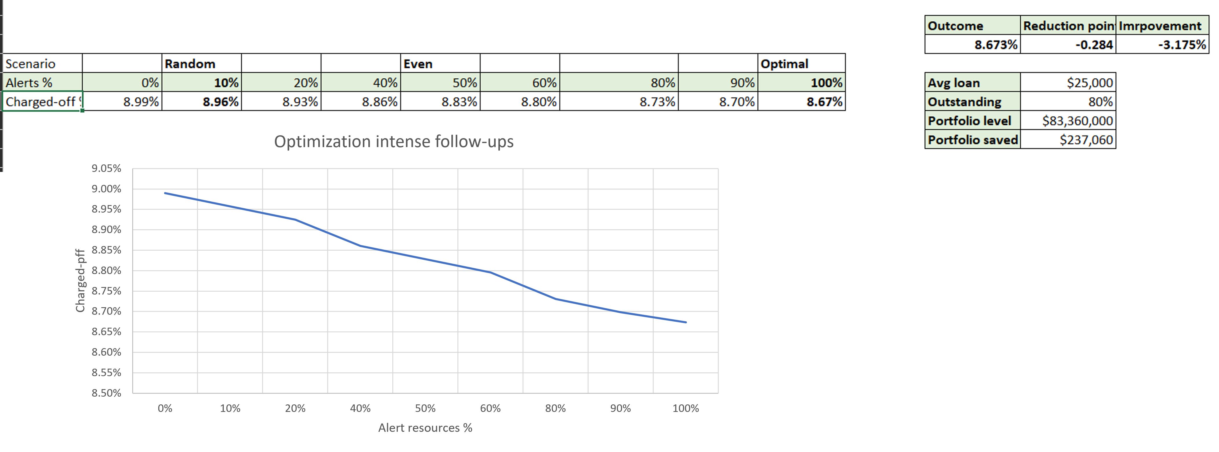
EWC to alert current portfolio defaults : See report
-0.284

Slide 21

Questions and discussion

